Slide 1

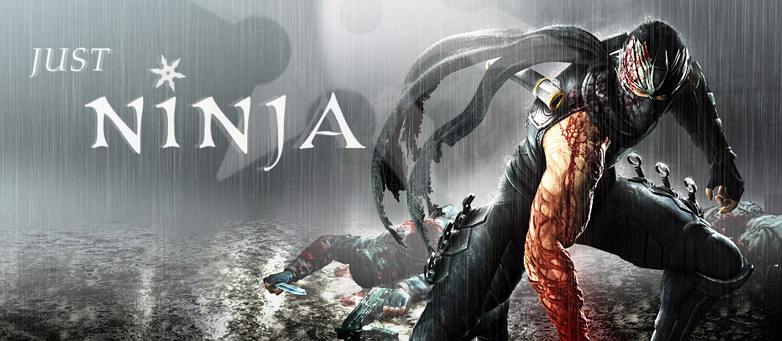

Slide 2

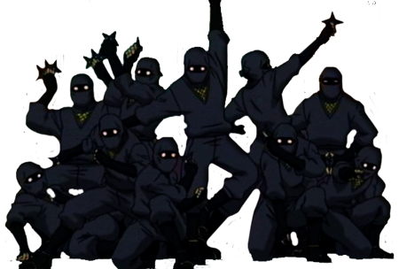
In your quest, you will encounter, many enemy ninjas and their minions

Slide 3
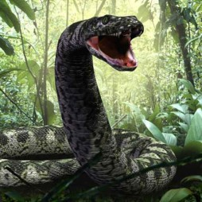
The
Snake

Slide 4
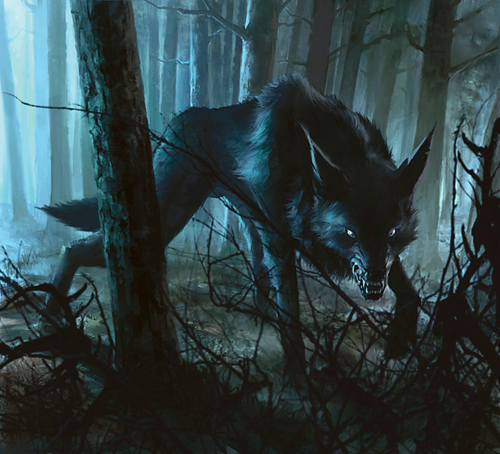
The
Wolf

Slide 5
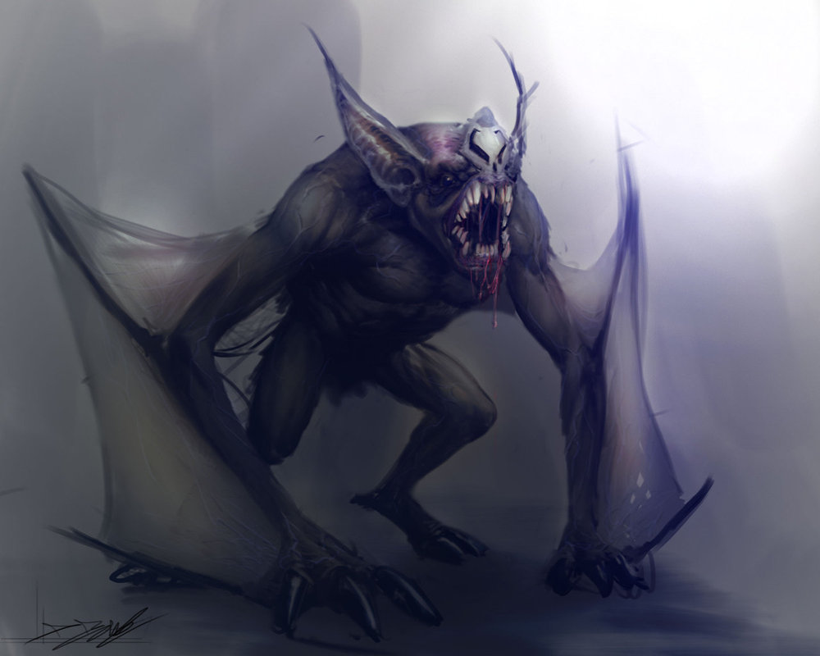
The
Bat

Slide 6
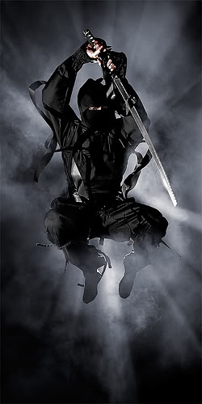
The Ninja
Swordsman

Slide 7
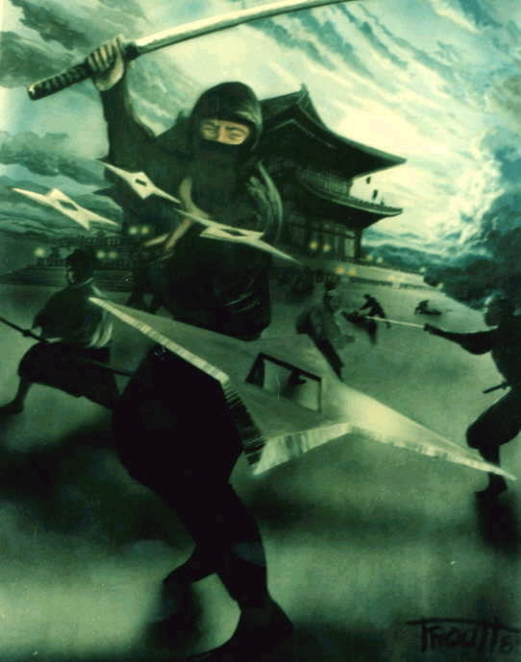
The Ninja
Assassin

Slide 8
Are you Prepared
To face them?

